Slide 1
Fraud Analytics
Project Mentor: Vinod
Team Members
Abhijeet
Priyanka
Tejaswini
Kumar Sanu
Maheshwari
Adil

Slide 2

Project : Fraud Analytics
Business Problem:
Insurance frauds cover the range of improper activities which an individual may commit in order to achieve a favorable outcome from the insurance company. The insurance industry has grappled with the challenge of insurance claim fraud from the very start. Improper payouts cause a hit to profitability and encourage similar delinquent behavior from other policy holders.
Business Objective :
Predict whether the claim made by claimants is Genuine or Fraud

Slide 3

FRAUD ANALYTICS FOR A HEALTH INSURANCE
CASE STUDY
Identified Fraudulent health insurance claims
Analyzing Insurance data to get warning of fraudulent claims

Slide 4
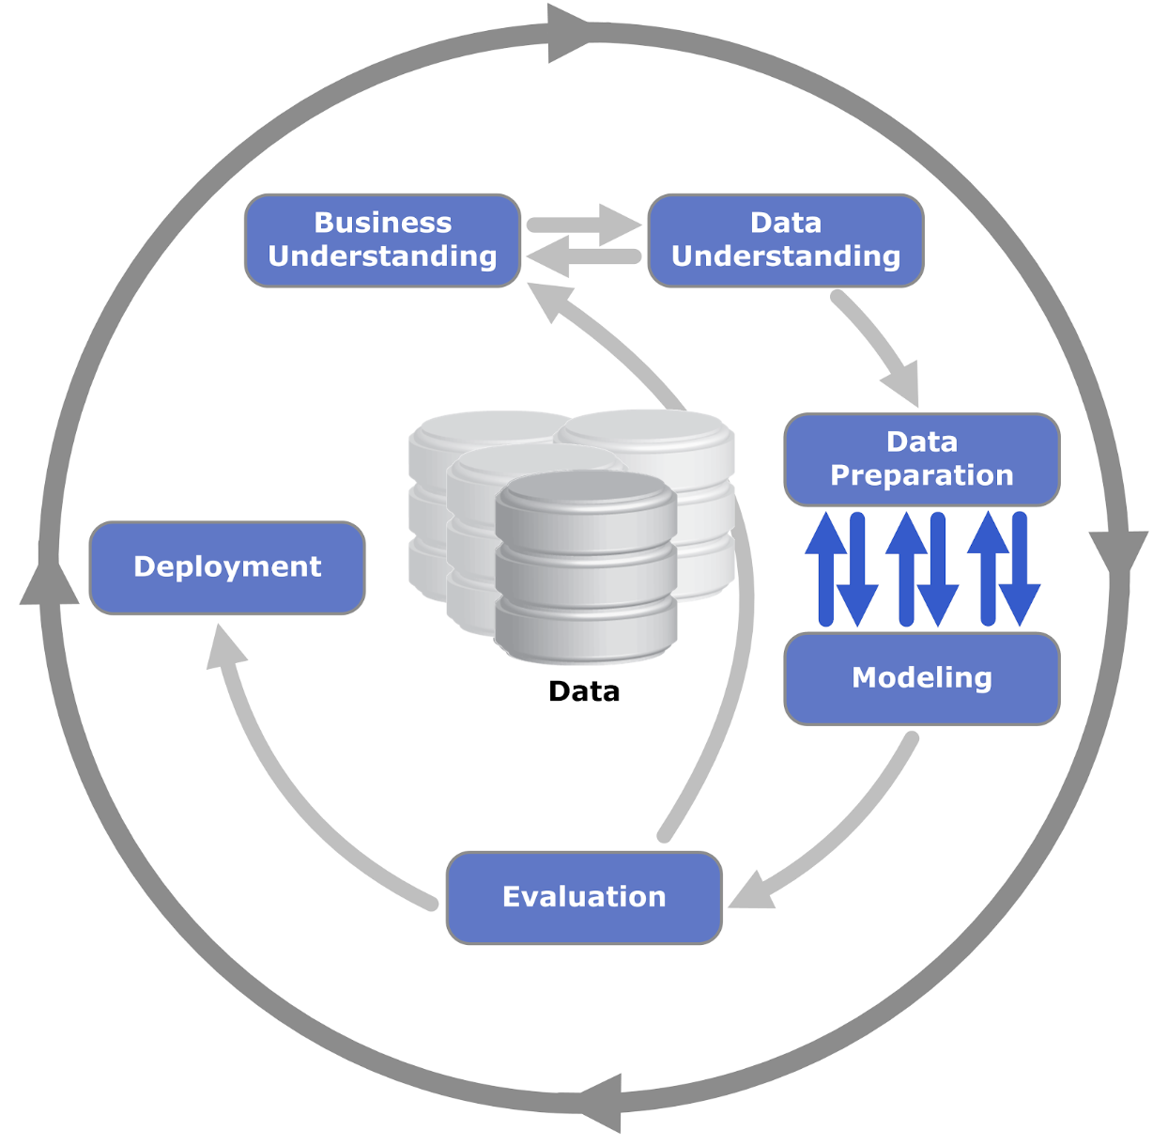
Architecture of Data Analytics

Slide 5

Data Understanding
Data contains total 24 attributes.
It was observed that data set is collection of categorical data and numerical data.
There are 13 Categorical variables and 11 Numerical variables
Result is one of the target label
Description of Variables :
0-Areas of service :
There are 7 areas of services where data on hospital facilities are collected
1-Hospital County :
There are certain counties in each area where the hospital services are provided
2-Hospital Id :
In each county, there are various types of hospitals with different Id numbers
3-Age :
There are patients of different age groups starting from 0 to 70 years and older. This includes new born baby as well
4-Gender : Male/ Female

Slide 6
Data Understanding
Description of Variables :
5-Cultural Group :
Different Cultural Groups like
Black who are called as African American.
White who are white American
Other Race – Groups other than above two
6-Ethnicity :
Spanish/Hispanic : Spanish speaking countries especially people from Central and South America
Non-Spanish : Main English speaking countries called Anglo Americans
7-No. of Days Spent in Hospital:
The average length of stay in hospitals (ALOS) is often used as an indicator of efficiency.
8-Admission Type :
There are 5 admission types 1)Emergency 2) Urgent 3) Elective 4) Newborn 5) Trauma
9-Home or Self Care, 10-ccs diagnosis code, 11-ccs procedure code and 12-APR-DRG
Patient Refined Diagnosis Related Groups are related to each other according to CCS(Clinical Classification Software) guideline attached.
Type of recommended care is covered under Home or Self care
ccs diagnosis code is the code depending on type of disease
ccs procedure code is the code for recommended clinical procedure to be followed.
Apr-drg description is the description of the disease

Slide 7
Data Understanding
Description of Variables :
13-Illness Code :
There are 5 illness codes:- 0 ) Stage unspecified , 1 ) Mild , 2) Moderate , 3 ) Severe ,
4 ) Indeterminate
14-Mortality Risk :
There are 5 Mortality Risk:- 1) Minor, 2 ) Moderate ,3) Major, 4) Severe
15-Surge_ Description – Type of Treatment – Surgical or Medical.
16-Weight_baby : Wherever the admission type is “New Born”, there will be some baby weight, otherwise it is 0.
17-Aburtion (Y/N) : Wherever, there is a “newborn” as type of admission, there is “N” for abortion. In all other cases it is “Y”
18-Emergency_Deptt: A medical treatment facility specializing in emergency medicine, the acute care of patients who present without prior appointment; either by their own means or by that of an ambulance. (Yes/No)
19-Total Charges : Includes charges for medical procedures, lab tests, supplies, medications etc. Total charges calculated by using Charge Description Master (CDM)

Slide 8
Data Understanding
Description of Variables :
20-Total Costs : Hospital costs vary according to how much they must spend to provide patient care, as opposed to how much a patient or insurer must spend to receive care.
21-Cost–to-Charge Ratios & Their Relevance: Hospitals typically compare their total charges to their cost using a cost-to-charge ratio determination.
22- Result (Target Label): 1 – Genuine Claim 0-Fraud Claim
23. Payment Typology : Method of Payment in insurance claim
5 categories of payment typologies are defined below:
Medicare
Medicaid
Other Governments
Department of Corrections
Private Health Insurance

Slide 9
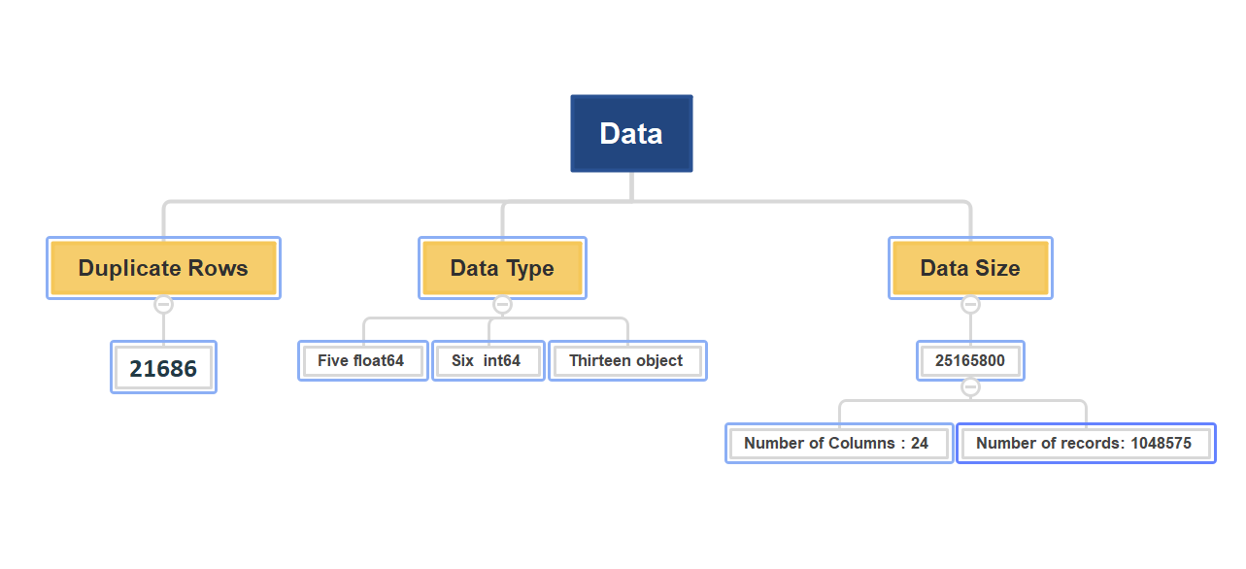

Data Validation
Data Validation

Slide 10

Data Validation
Rename columns:
Rename Variable names as below
Mortality risk: mortalityrisk
ratio_of_total_costs_to_total_charges: ratio_ofcost_to_charge
Home or self care : home_or_selfcare
Emergency dept_yes/No : emergency_dept
Null values in columns: Total NA values present in the below variables
Hospital Id= 2455
Hospital County= 2455
Area Service= 2455
Mortality Risk= 39

Slide 11

Data Preparation and EDA
Data preparation is a self-service activity that converts disparate, raw, messy data into a clean and consistent view. The process includes cleaning, transforming, organizing and collecting data.
Data Cleaning and Inspection
Removed Duplicate Record.
Removed Null values which are categorical in nature
For numerical data compute missing values by using median imputer.
Drop the below columns which are not required for prediction as per domain knowledge.
(Area_Service, Hospital Id, Cultural_group, Ethnicity, Abortion, Tot_cost, Weight_baby)
Datatype of Mortality risk converted into integer .

Slide 12
Data Preparation and EDA
EDA (Exploratory Data Analysis) :
Exploratory Data Analysis (EDA) is the philosophy of analyzing datasets to do summarize
their main characteristics, usually employing graphs and data visualization techniques.
Univariate Analysis:- Focus on column Result which gives prediction 25% claims are genuine and 75% claims are fraud.
Result
Fraud Claims(0) : 257640
Genuine Claims(1) : 766794
Data Type conversion
Float data type variables converted to integer data type. (Mortality Risk, Hospital Id, Total charge, Ratio of cost to change)
Notes:
) :

Slide 13

Visualization
We visualize data by using Tableau

Slide 14
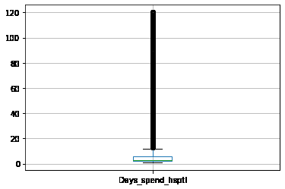
Data Preparation and EDA
Outlier Detection
We can see that we do have outliers in this dataset, and we need to handle them.
We will use IQR (Interquartile Range Method) to deal with outliers
We are working on the variable Days spend in hospital ,Total cost ,Ratio of total cost and total charge Surg description ,Home or self care CC's daignosis code by using IQR
Boxplot to detect outliers

Slide 15
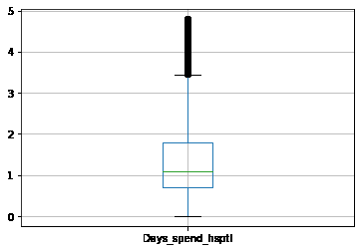
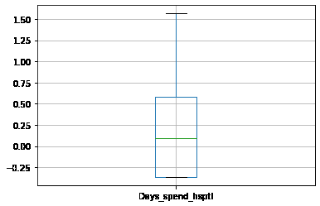
Data Preparation and EDA
Outlier Detection
Below is the Boxplot after applying
logarithm transformation Below Boxplot after computing the interquartile range

Slide 16

Feature Engineering:- This is the process of extracting features that can help improve the Machine Learning algorithms.
Label Encoding for non-numerical columns:-
By using Label encoder we Replace and encode the categorical data with numeric values for feature.
Feature Selection:-
This is the process of selecting features which are most relevant in predicting the output variable.
ExtraTrees Classifier :- For Feature selection we have used ExtraTreesClassifier technique which gives score for each feature of your data, the higher the score more relevant it is
After using ExtraTrees Classifier information, we get feature like Surg_Description which gives less score to our target variable. So we dropped that feature.

Slide 17

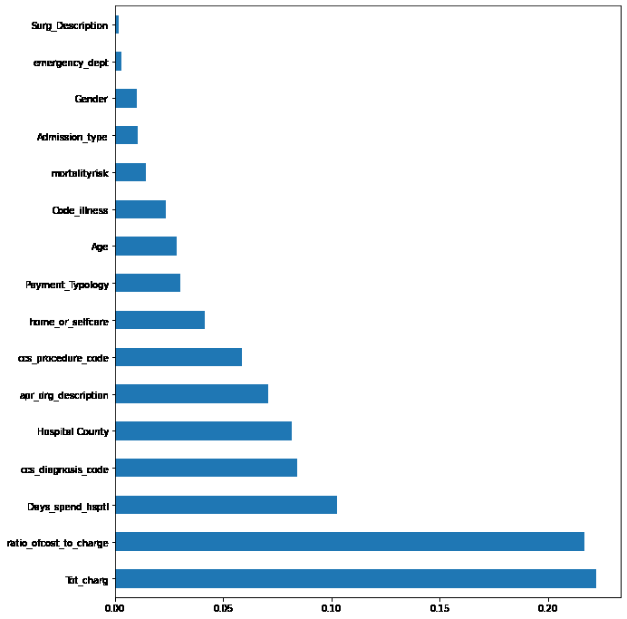
To visualize the feature importance Let us create a Barh chart that shall prove to us that those features do no affect charges.

Slide 18
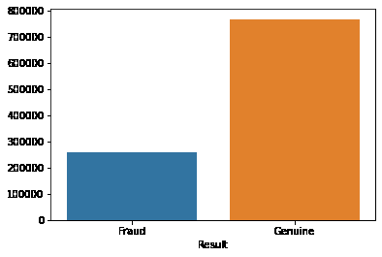
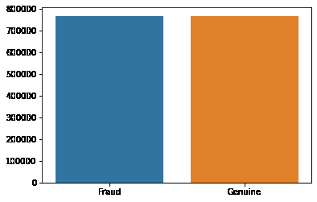
Data Pre-Processing
Balancing the Data
Convert the imbalanced data set into balanced one by using SMOTE
SMOTE

Slide 19

Data Modeling
Split the data into features and label
Here we split our original dataset into two: features (that will be used in the model) and label (our target variable).
Train-Test Split:
Split the data into Training and Testing Sets to avoid overfitting
Machine Learning Models Implementation
We have tried different classifiers by using techniques like Hyperparameter tunning, Bootstrap…..etc.
We evaluate by comparing accuracies and performances of each Model

Slide 20
Model Building and Evaluation
S.No | Model | Training Score | Testing Score | F1 score |  | Overall Accuracy
 |  |  |  | 0 | 1
1 | XG Boost | 0.8349 | 0.8327 | 0.79 | 0.85 | 0.83
2 | Random Forest | 0.8672 | 0.8206 | 0.79 | 0.99 | 0.87
3 | Bagging Decision Tree Classifier | 0.9999 | 0.8242 | 0.78 | 0.83 | 0.81
4 | Easy ensemble classifier | 0.8186 | 0.8196 | 0.76 | 0.83 | 0.80
5 | Gradient Boosting | 0.8002 | 0.8036 | 0.71 | 0.82 | 0.77
6 | Adaboost classifier | 0.7476 | 0.7509 | 0.68 | 0.81 | 0.76
7 | Logistic regression | 0.4979 | 0.4995 | 0.68 | 0.81 | 0.76
8 | DecisionTree Classifier | 0.9999 | 0.7323 | 0.73 | 0.73 | 0.73
9 | Gaussian Naive Bayes | 0.5542 | 0.5645 | 0.65 | 0.27 | 0.53
10 | KNN | 0.9051 | 0.5090 | 0.48 | 0.53 | 0.51
11 | SVM | 0.5210 | 0.5020 | 0.43 | 0.53 | 0.49

Slide 21
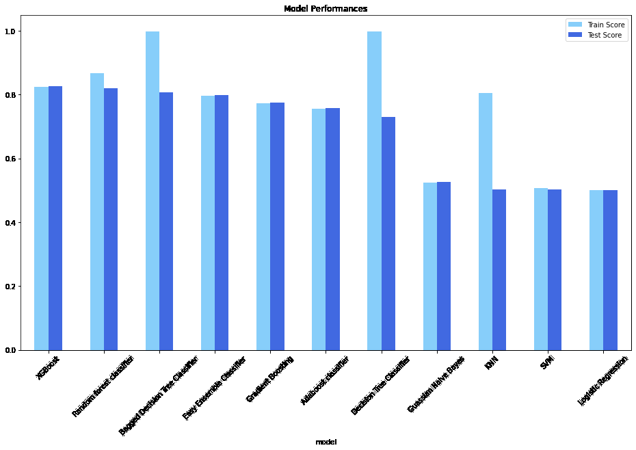
Plot graph for All Model performances

Slide 22
Finalize the Model
XGBOOST Classifier
To improve our Model accuracy we perform algorithm tunning.
We have finalized XGBoost Classifier Model which predicts below accuracies
Training Accuracy = 0.8349
Testing accuracy = 0.8327

Slide 23
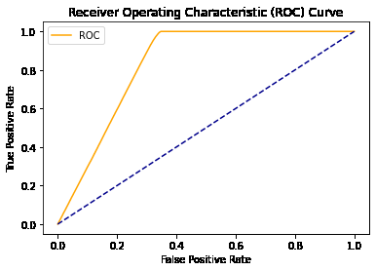
ROC Curve
Training roc_auc Score =0.8377
Testing roc_auc Score =0.8373

Slide 24

Challenges ? How we overcome on this?
As given dataset is very large so we are facing difficulties to do visualization
To see quick result we did visualization in Tableau.
Dataset contains Imbalanced data its challenge to how to handle the large dataset with imbalanced one.
To overcome this we have tried different sampling Techniques like
1) Down Sampling using nearmiss
2) Up Sampling using random over sampler.
3) Smoteomek
4) Smote gives better result
We are facing difficulties while doing model building as it takes lot of time to train Model.
To overcome this we have taken sample of overall data and train the Model and compare their Accuracies.
By comparing performance and accuracies of all Models we have finalize the Random Forest Classifier Model which gives best accuracy.

Slide 25

Deployment
Deployment has done by using Streamlit

Slide 26
Thank You….

